Slide 1

Washington State Electric Vehicles
January 2024

Slide 2

Objectives
We are performing an exploratory data analysis (EDA) of electric vehicles (EVs), specifically of what factors (e.g. income) are associated with electric vehicle purchase, how existing infrastructure in an area (e.g. charging stations) provides insight into EV ownership in that area. Other variables we have followed include EV Make and Model, EV Type (BEV vs. PHEV), EV Price and Year, and overall geographic location that may correlate to an increase in EVs.

Slide 3

Questions Addressed
Income
Make and Type
How does income affect the likelihood of a consumer to own an EV, and does it affect the brand they will tend to purchase?
What is the ratio of BEV vs PHEV ownership? Does median income make an impact on which of these EV’s or which make of EV one is likely to buy?
Charging Stations
Is there a strong correlation between the number of EV charging stations in an area and EV ownership? Is there a correlation between charging stations and the median per capita income of an area?

Slide 4

Methodology and Sources
Population:
Washington State Electric Vehicle (BEV or PHEV owners)
Analysis Performed:
Comparative analysis
Per capita medians
Linear regression
Data Plotting
Sources:
https://www.kaggle.com/datasets/utkarshx27/electric-vehicle-population-data?resource=download
https://data.census.gov/

Slide 5
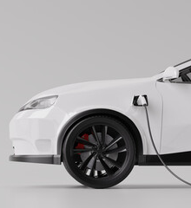
Population
Location
N = 112,633
Exploratory data analysis of an electric vehicle population in a certain geographic area. We have chosen, in part due to the region’s particular affinity to electric technological innovation and alternative energy options, to refine our analysis to Washington state.
Data
We have utilized datasets from two sources: a 2023 EV dataset published on Kaggle.com that shows the Battery Electric Vehicles (BEVs) and Plug-in Hybrid Electric Vehicles (PHEVs) that are currently registered through Washington State Department of Licensing (DOL); and U.S. Census Bureau data (agsc5) for 2022, the latest available. The former gives us a dataset of 8340 unique electric vehicles with which to work.

Slide 6

Key Insights
There is a strong positive correlation between ownership of EV by per capita income
EV ownership by zip code is spread out widely, with no discernable correlation found between wealthier zip codes and EV ownership
PHEVs are purchased by a larger range of Median Incomes Per Capita, with the median income being $50,000 per year versus nearly $60,000 for BEVs
When using the Make of EV as the independent variable, its price/brand is strongly positively correlated to the Median Income Per Capita of the buyer
When we conducted linear regression of number of charging stations vs. income per capita there was a very weak positive correlation of r = 0.12

Slide 7
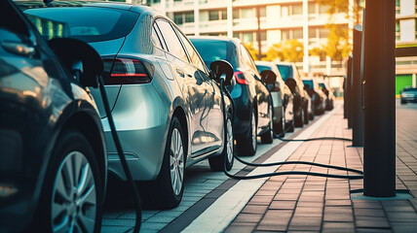
In-Depth Analysis

Slide 8

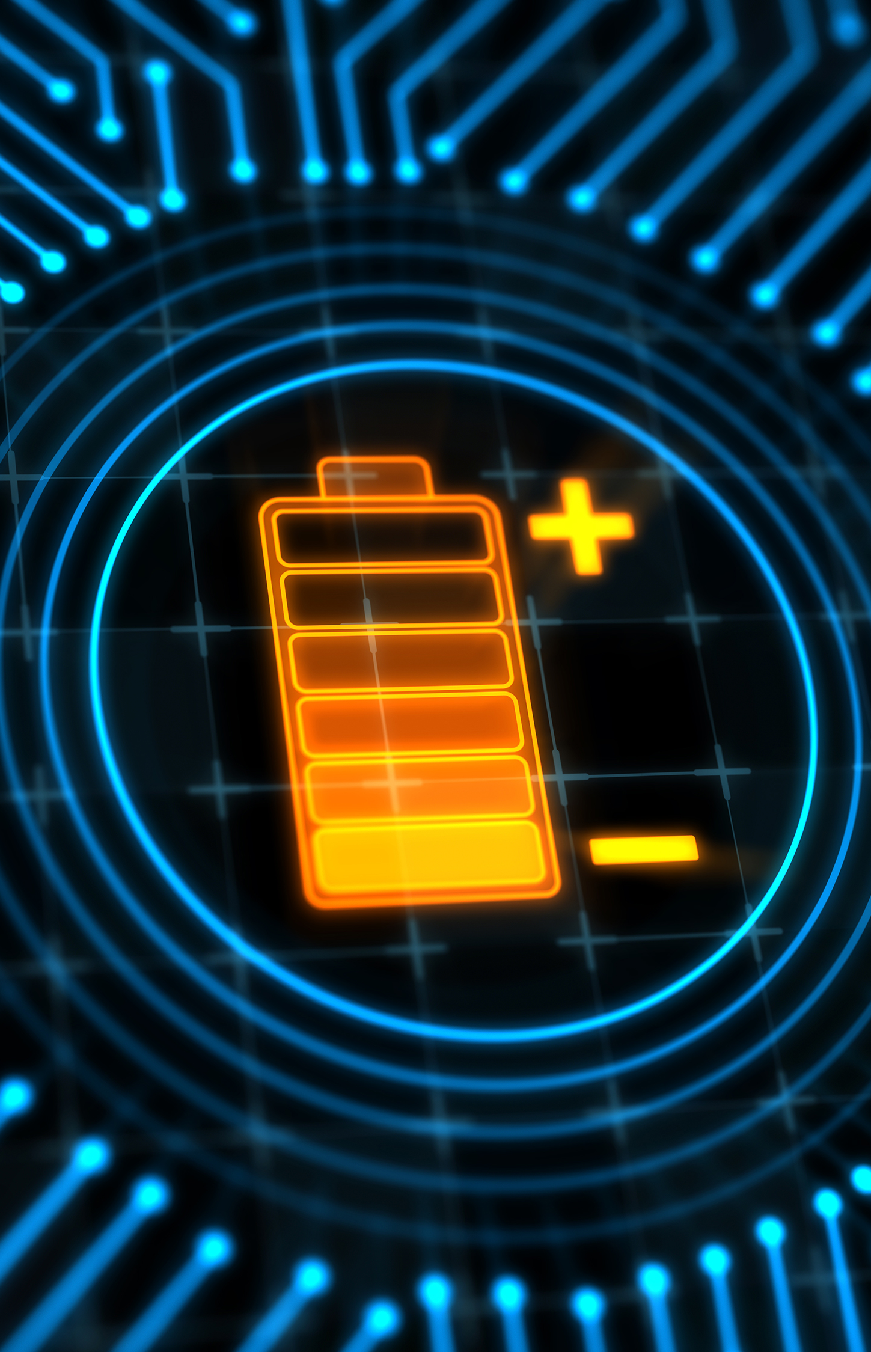
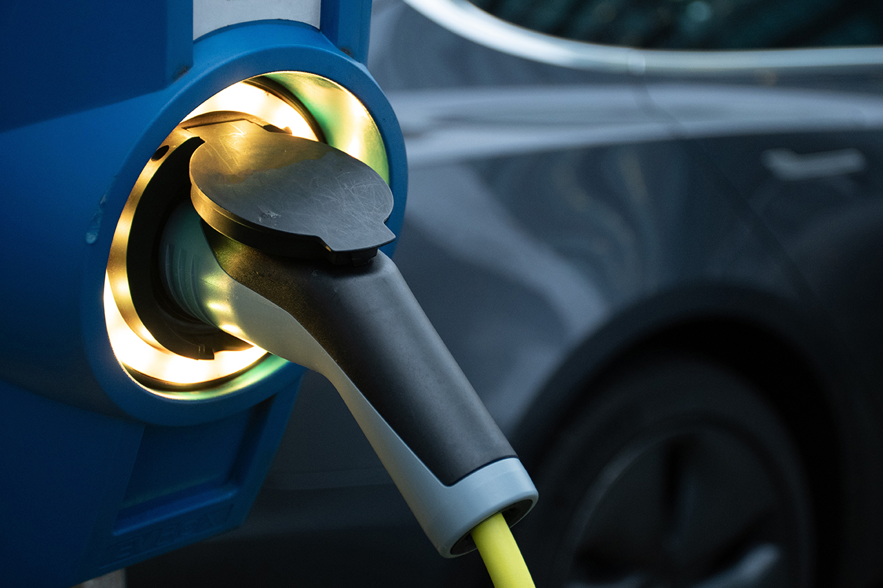
Section One
Income
Make and Type
Charging Stations
Notes:
Firstly, we predicted that income would have a positive correlation with the number of EVs in a given area.

Slide 9
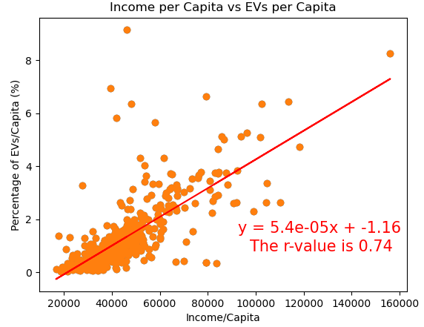
Ownership by Income
NOTE
Overall, there is a clear positive correlation between ownership of EV by per capita income with r = 0.74
Notes:
Overall, there is a clear positive correlation between ownership of EV by per capita income with r = 0.74

Slide 10
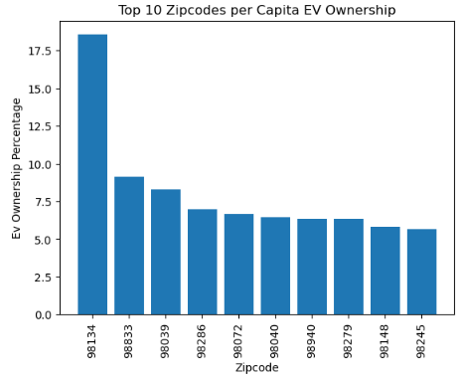
Top Zip Codes for EV Ownership
NOTE
Zip code 98134 leads the state with 18.45% of the population owning EV’s
There is a sizeable gap (6-7%) between EV ownership by zip codes, demonstrating how spread-out ownership is
Notes:
To better assess the prevalence of EVs, we identified the ten zip codes with the highest EVs per capita. In short, zip code 98134 leads the state with 18.45% of the population owning EVs, nearly twice that of the second zip code. The general trend showed a rather bifurcated EV per capita count overall, with there being a sizeable gap (of ~6-7%) between the mean top EV per capita zip codes and that of the bottom, all of which reported at less than 0.1% of the population. Thus, we see just how spread out our EV ownership data is across the state, with the urban areas near the coast far outweighing the rest of the state inland.

Slide 11
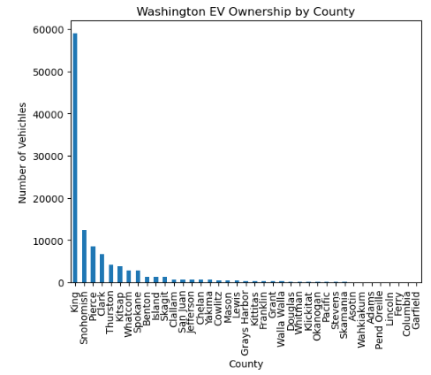
Ownership by County
NOTE
There is a significant drop in EV ownership outside of King County (where Seattle is), although more data would be needed to truly understand this dynamic
Notes:
With the majority of our charts breaking data down by zip codes or by county, there is a precipitous drop in EVs outside of these former regions (e.g. King County around Seattle comprises 52% of total EV registrations in the entire Washington state). We must admit, though, that fully understanding this dynamic requires external research to fill in the holes our datasets cannot.

Slide 12
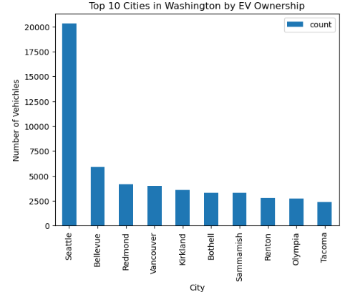
Ownership by City
NOTE
Redmond, WA (in King County) has the highest EV ownership by far of any city, which is also the headquarters of Microsoft (which could indicate a population that makes a higher income and is more technologically “savvy”)
Notes:
For example, Redmond, WA (in King County), zip code 98052, by sheer volume contains the most EVs by an exponential margin. The 2916 unique EVs registered there is numerically the most of all zip codes and translates to 3.77% of Population Percentage/EVs Per Capita, which is in the top three in the state. When one researches the brick-and-mortar make-up of Redmond, one easily realizes that it is the corporate headquarters of Microsoft—the workers of which would tend to be more technologically “savvy” and likely to be more amenable to EV ownership.

Slide 13

Income - Notes
Method
Results
First, we addressed that the amount of owned EVs in one zip code could be higher than another simply due to population size. To accommodate for this, our analysis utilizes income per capita & ownership of EVs per capita for each zip code. Next, we plotted this data in a scatterplot and used a linear regression to determine the strength of the correlation between these two variables.
After analysis we did find that the make of an EV owned strongly positively correlates with median income per capita of buyers. We also found that the majority of EV’s owned per capita and overall are spread across zip codes and counties throughout Washington state. While most ownership appears to be in King County, more analysis was necessary to get the full picture.

Slide 14
Section Two
Income
Make and Type
Charging Stations

Slide 15
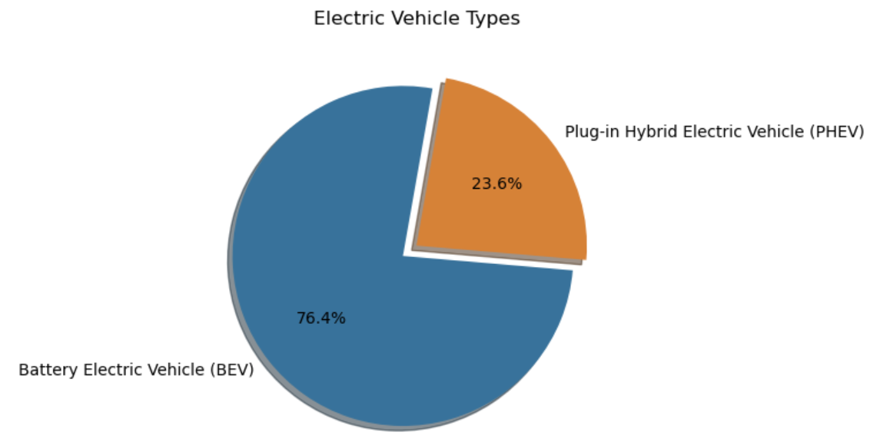
BEV and PHEV Ownership
NOTE
While in total, 76.4% of our sample owns Battery Electric Vehicles, and only 23.6% owns Plug-in Hybrid Electric Vehicles, this is not representative of the population in terms of other factors
Notes:
Across total, 76.4% of our dataset own Battery Electric Vehicles (BEV), while only 23.6% own Plug-in Hybrid Electric Vehicles (PHEV). However this alone is not an accurate representation of the population, and we needed to examine further.

Slide 16
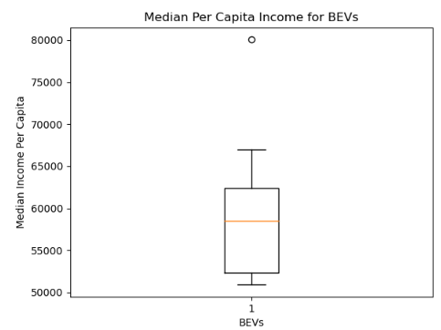
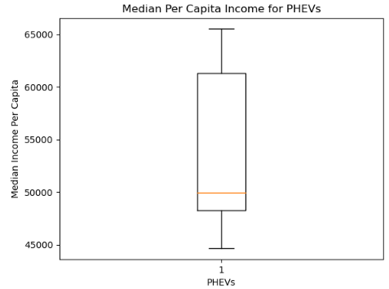
Ownership by Income
BEV vs. PHEV
Notes:
Two types of EVs we have differentiated are Battery Electric Vehicle (BEV) and Plug-in Hybrid Electric Vehicle (PHEV). In general, independent of the make, PHEVs are cheaper relatively to their BEV counterparts. In our charts measuring this relationship, we see that more PHEVs are purchased by a larger range of Median Incomes Per Capita, with the median income being $50,000 per year versus nearly $60,000 for BEVs. Also notable in the BEV box chart, we notice an outlier for BEVs at the $80,000 income level. Causes for this could be anything from spontaneous purchases to a sudden influx extra money, but more analysis and data would be needed to investigate.

Slide 17
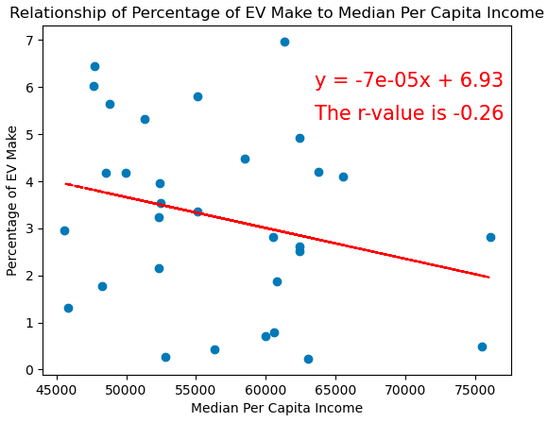
EV Make by Median Per Capita Income
NOTE
There is a negative correlation between per capita median income and EV ownership by make with r = -0.26
Notes:
Since we set out to analyze the relationship of income and EV ownerships, we organized all EVs in our original dataset by Make. This allowed us to get a better sense of how luxury brands (i.e. Lexus, Mercedes, Land Rover, etc.) are faring in the EV market. We found a negative correlation between Per Capita Median Income and EV Ownership per Population (r-value = -0.26). After filtering the outliers, we saw that, while higher income certainly allows for more spending power, the prevalence of expensive luxury EVs seems to be in its seed stage. In other words, because the higher Per Capita Income in an area does not denote that there will be more EVs in that area, there remains speculation as to why the luxury, more costly EV market is so outnumbered compared to cheaper counterparts. This negative slope could also be indicative of general disinterest to buy and/or switch to EV vehicles amongst wealthier populations with traditional gas cars. At the very least, we can conclude that EVs Per Capita are not indicative of the Per Capita Income; rather, we see similar purchasing rates across socioeconomic areas with EVs of different Makes and prices being accessible to all.

Slide 18
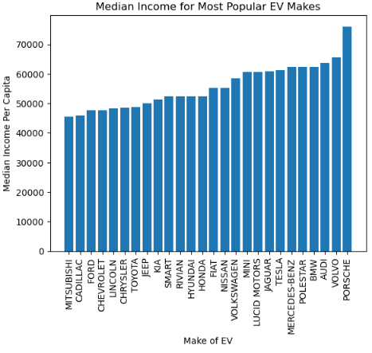
Make by Median Income (cont.)
NOTE
Make of an EV owned strongly positively correlates with median income per capita of buyers, with luxury brands being purchased more often by high-income purchasers.
Notes:
What we also did find, as to be expected, was that, when using the Make of EV as the independent variable, its price/brand is strongly positively correlated to the Median Income Per Capita of the buyer. We used a bar graph to visualize the correlation between Median Per Capita Income and the specific EV Makes. As one might imagine, we found that Porsche, Land Rover, Volvo, and Audi purchases were the most numerous among those with the highest incomes (all $60,000+ Median Income Per Capita). On the other end of the spectrum, Mitsubishi, Cadillac, and Ford were the EV Makes most bought by those with lowest Median Per Capita Income. We concede that we have not introduced other variables, such as MSRP and Model and Age, here into a multivariable correlation but we feel that our charts illustrate our overall analytical hypotheses.

Slide 19
Make and Type - Notes
Method
Results
All data pulled from the Census API and the cleaned Kaggle EV dataset were grouped by the make and type (PHEV/BEV) of EV. After filtering the data to only show the makes of EV that shows up in more than 10 zip codes we manipulated the data frame into a variety of visualizations.
While the large majority of the total sample appeared to own BEV vehicles as opposed to PHEV, ownership by income showed that the majority of lower income individuals owned PHEV, while higher income individuals are more likely to own BEV. We did find a negative correlation between per capita median income and EV ownership by make with r = -0.26

Slide 20
Section Three
Income
Make and Type
Charging Stations

Slide 21
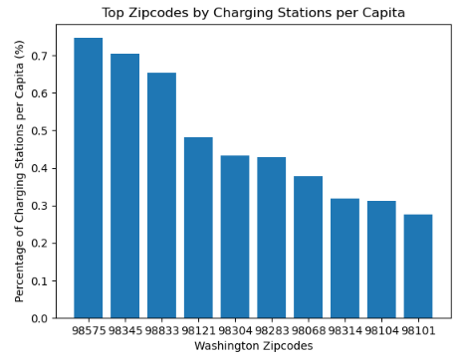
Charging Stations by Zip Code
NOTE
There is no recognizable correlation between income and number of charging stations.
Notes:
We noticed a couple of important relationships. Our bar graph shows the 10 zip codes with the largest Charging Station Percentage of Population. Most notably, any strong correlation between income and charging stations is absent; thus, the initial presumption that “richer” areas would necessarily have more “modern” infrastructure features, in this case charging stations, falls short. Zip code 98757 has the highest Per Capita Charging Stations and a quick look into this area shows that it is on the edge of Olympic National Park. This leads one to surmise that EV Charging Stations are perhaps better studied in terms of strategic location in conjunction with public funding abilities. Zip code 98757 has the highest Per Capita Charging Stations and a quick look into this area shows that it is on the edge of Olympic National Park. This leads one to surmise that EV Charging Stations are perhaps better studied in terms of strategic location in conjunction with public funding abilities.

Slide 22
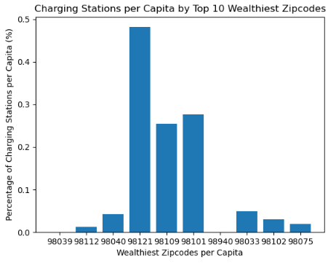
Charging Stations by Wealthy Zip Codes
NOTE
There is no obvious correlation between wealthier zip codes and the number of EV charging stations
Notes:
Just as gas stations are essential to the infrastructural capacity of traditional vehicles, charging stations play an important role in providing access to EV ownership. As in the prior section, we hypothesized a positive correlation between EV Charging Stations and the Number of EVs in that area, as well as between EV Charging Stations and area Income. Again, we parsed our data points so that our metrics are all per capita and by zip codes. For example, we calculated the EV Charging Stations per capita by presenting the number of them in each zipcode as a percentage of that zip code’s population. Thereby, our results would not be skewed by the reality that larger and more populated areas able to purchase EVs would most likely necessitate more stations.
To support this, we graphed the previous slides bar chart showing highest Per Capita Income zip codes vs their Per Capita Charging Stations (%) There was no particular correlation noticeable.

Slide 23
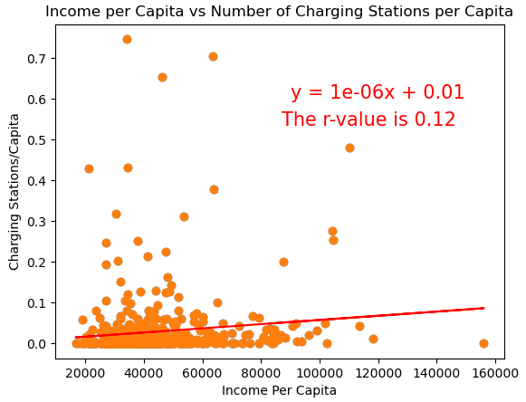
Income vs. Charging Stations Per Capita
NOTE
When we conducted linear regression of number of charging stations vs. income per capita there was a very weak positive correlation of r = 0.12
Notes:
In fact, when we regressed the two variables, we arrived at a near zero r-value of 0.12, denoting a very weak positive correlation.

Slide 24
Charging Station - Notes
Method
Result
To determine if there is a correlation between these two factors, our group first obtained a dataset from Transportation.gov listing all public charging EV charging stations in the state of Washington. Next, we ranked the top 10 zip codes according to their population of charging stations and compared those to the top 10 zip codes by EV ownership.
Surprisingly, of our top 10 zip codes with the most EV ownership, not many also appeared on the list of zip codes with the most charging stations. Upon graphing this data in a scatterplot and calculating a linear regression we get a R-Value of 0.12. This supports that there is not a strong correlation between the charging stations available in an area and per capita income.

Slide 25
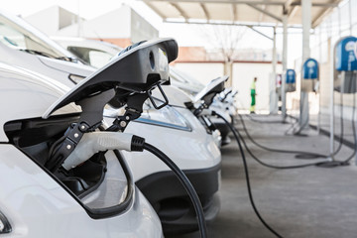
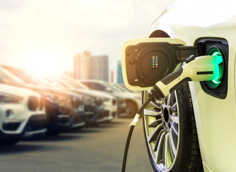
Thank you
Ben Comfort
Barrett Fudge
Charity Ovando
Michael Willis

